Slide 1

Analyzing the Impact of Car Features on Price and Profitability
By Nayan Jain

Slide 2
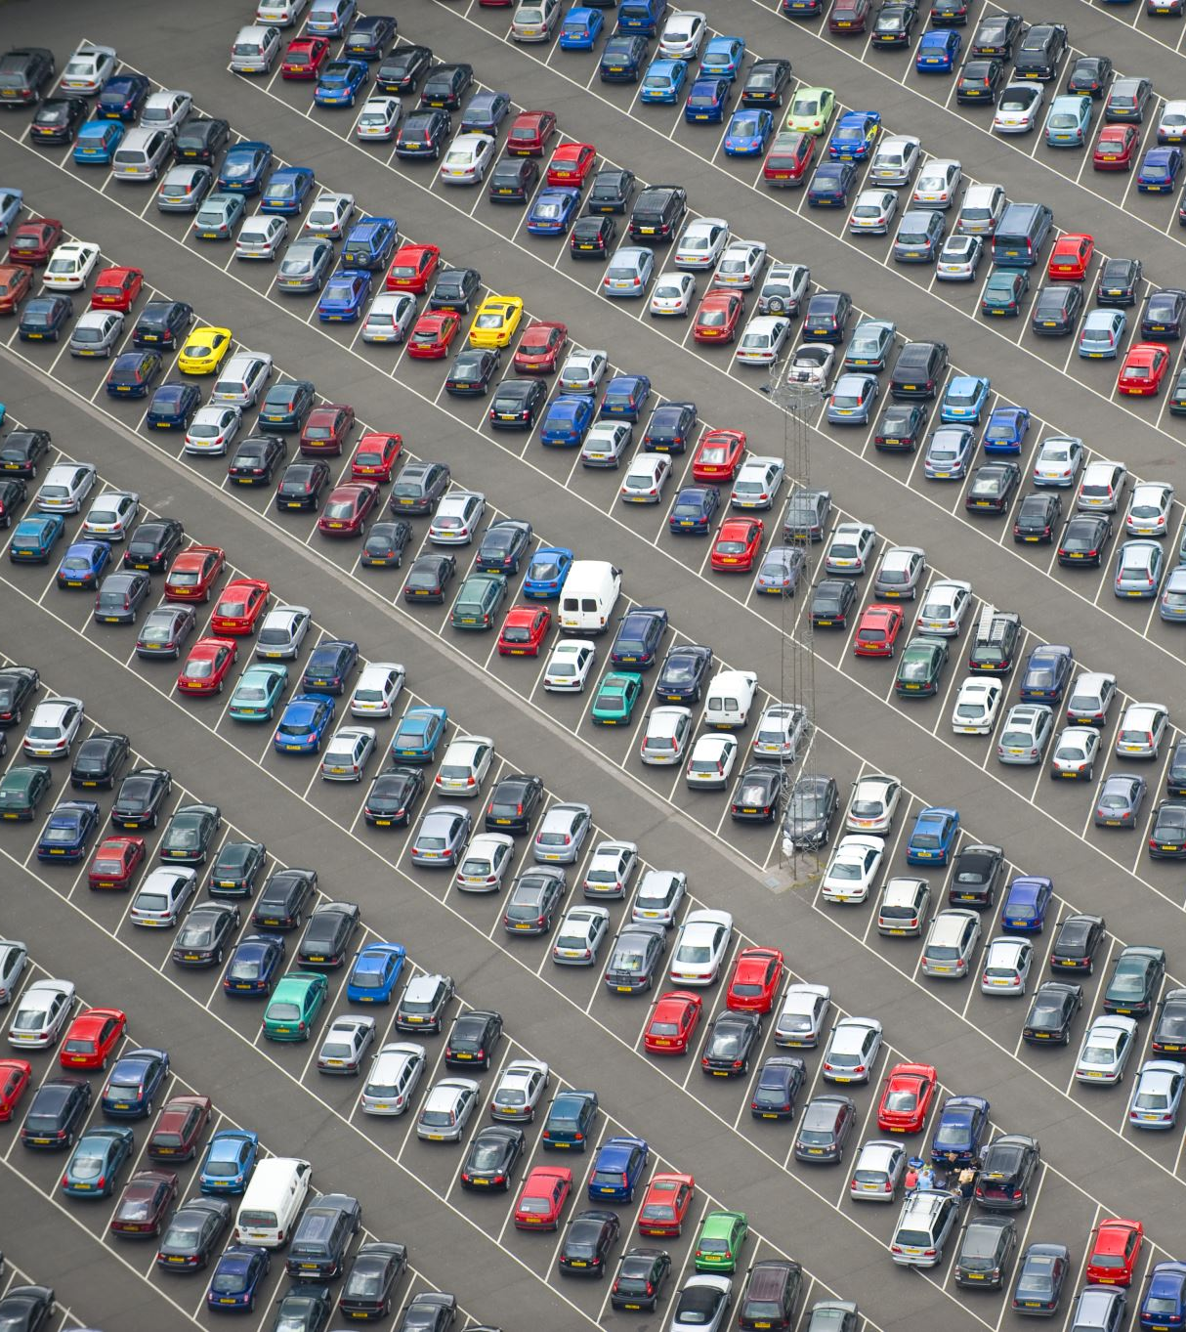
Project Description
The automotive industry has undergone significant transformations in recent decades, witnessing a notable shift towards fuel efficiency, environmental sustainability, and technological advancements. In response to rising competition, manufacturers are actively seeking to reshape the consumer landscape.
This project focuses on analyzing the impact of car features on the pricing of manufactured vehicles. As a Data Analyst, the objective is to provide insights on optimizing pricing and product development decisions for the car manufacturer. The goal is to maximize profitability while aligning with consumer demand.
The dataset, titled "Car Features and MSRP," encompasses comprehensive information about multiple car models and their specifications. It can be accessed on Kaggle, courtesy of Cooper College in New York City.

Slide 3

Project Description
Cleaning:
Performed data filtering to remove blank cells from the dataset.
Conducted numeric value replacement in the car model variable.
Eliminated N/A and Unknown values from the dataset.
Assumption:
Given that cars tend to provide higher mileage on highways compared to city roads, I prioritized the Highway MPG variable as it is considered more relevant for analyzing fuel efficiency.

Slide 4
Approach
Utilized descriptive statistics, regression analysis, and visualization techniques to analyze and present the data effectively.
Employed descriptive analysis to determine the mean of car's feature variables, which were further visualized through charts and graphs.
Applied regression analysis to identify the relationships and dependencies between independent variables (car features) and the car's price.
Observed a missing column in the data, specifically the manufacturing cost, which plays a crucial role in calculating profit margins and other financial aspects.
Tech – Stack Used
MS Excel

Slide 5
Task: How does the popularity of a car model vary across different market categories?
Among all the market categories, the following three combinations: "Hatchback, Flex Fuel", "Flex Fuel, Diesel", and "Crossover, Flex Fuel, Performance" exhibit the highest values.
The Crossover market category comprises the highest number of car models.

Slide 6
Task: What is the relationship between a car’s engine power and its price?
There exists a positive relationship between engine power and car price, where an increase in engine power corresponds to an increase in the price of the car.

Slide 7
Task: Which car features are most important in determining a car’s price?
The variable "Engine Cylinders" exhibits the strongest relationship with MSRP, indicating a significant impact on the car's price. Conversely, the variable "Number of Doors" demonstrates minimal influence on the MSRP.

Slide 8
Task: How does the average price of a car vary across different manufacturers?
Bugatti showcases the highest average price among the car models, while Mitsubishi stands out with the lowest price.

Slide 9
Task:What is the relationship between fuel efficiency and the number of cylinders in a car’s engine?
Fuel efficiency demonstrates an inverse relationship with the number of engine cylinders, with higher cylinder counts resulting in lower fuel efficiency.
The scatter plot analysis reveals that cars with 4 engine cylinders exhibit the highest level of fuel efficiency.

Slide 10
Task: How does the distribution of car prices vary by brand and body style?
Analysis of the stacked column chart highlights that the Body style of Mercedes-Benz makes the highest contribution to the overall price of the car.
Conversely, Oldsmobile demonstrates the lowest contribution to the car's price.

Slide 11
Task: Which car brands have the highest and lowest average MSRPs, and how does this vary by body style?
Analysis of the clustered chart reveals that the Coupe style of Bugatti and the Convertible style of Maybach exhibit the highest average car prices.
In contrast, Oldsmobile demonstrates the lowest average car price.

Slide 12
Task: How do the different features such as transmission type affect the MSRP, and how does this vary by body style?
The scatter plot demonstrates that the Automated-Manual Coupe transmission type is associated with the highest car prices.
Additionally, the Automated-Manual Coupe transmission type emerges as one of the most popular choices among car buyers.

Slide 13
Task: How does the fuel efficiency of cars vary across different body styles and model years?
The line chart illustrates a positive relationship between time and fuel efficiency, showing an increase in fuel efficiency as time progresses.

Slide 14
Task: How do the car’s horsepower, MPG, and price vary across different Brands?
Analysis of the bubble chart reveals a direct correlation between Engine Horsepower (HP) and car price, indicating that higher Engine HP corresponds to higher prices.
Furthermore, the chart shows an inverse relationship between Highway MPG and car price, indicating that higher Highway MPG is associated with lower prices.

Slide 15

Result
Companies should prioritize the production of high or good fuel efficiency cars to ensure affordability for a majority of the population.
The impact of the Automated-Manual transmission type is significant, as having both automated and manual gear systems in a single car proves more advantageous compared to a single gear system.
The Coupe body style makes the maximum contribution to the MSRP (Manufacturer's Suggested Retail Price) of the car.
Overall, fuel efficiency and the Coupe body style have a substantial impact on car price and profitability.
For a more in-depth analysis, please click on the link provided below.
Analyzing the Impact of Car Features on Price and Profitability.xlsx

